Slide 1
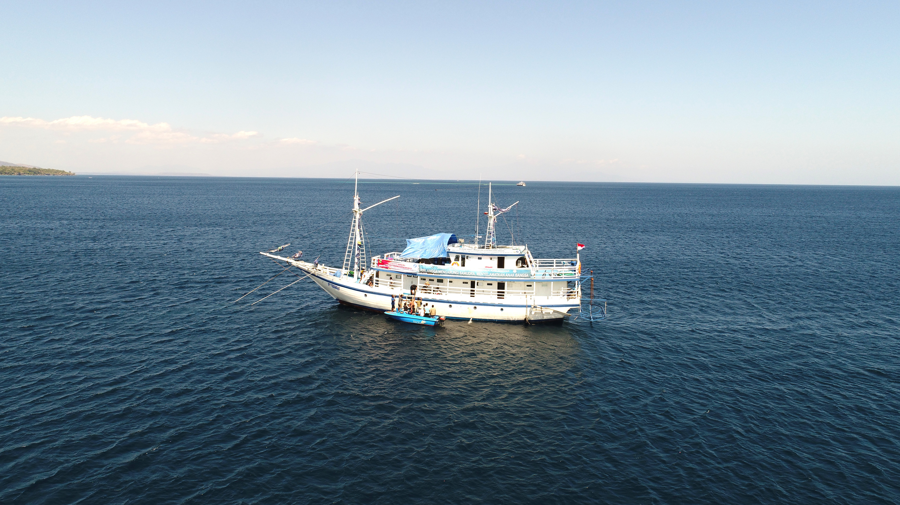
Strategic Practices in Bringing the Solution for Community Health in Small Islands

Slide 2
17.580 islands
3 thousands inhabitant

Slide 3
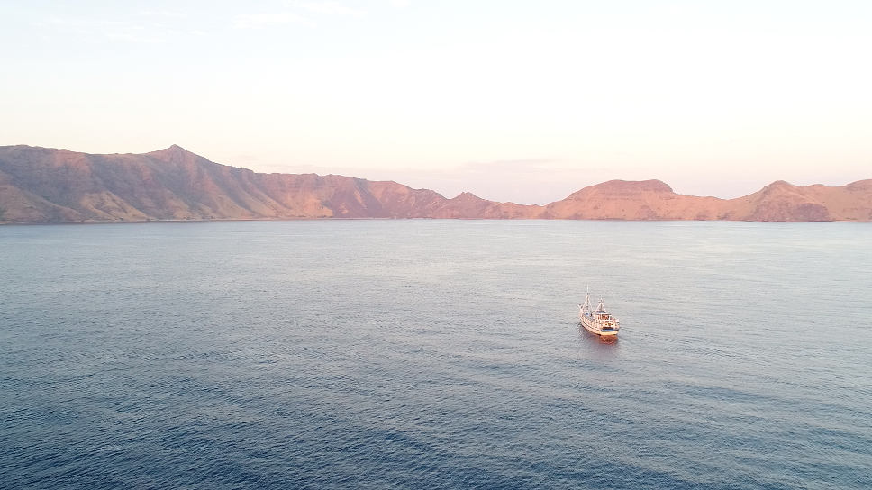
PROBLEMS
People in the remote islands may have some primary health care through the government medical services called rural health centre or PUSKESMAS.
Once they need to be referred to specialists or to hospital →the problems come:
Too far to sail across the ocean
Lack of means of transportation
Too expensive so they cannot afford
Sometimes it is not possible cause of the sea condition is hazardous to sail.
Potential to be neglected and to be forgotten → disabled or die
For this reason we come to their islands:
to stop their silent crying
to bring happiness

Slide 4
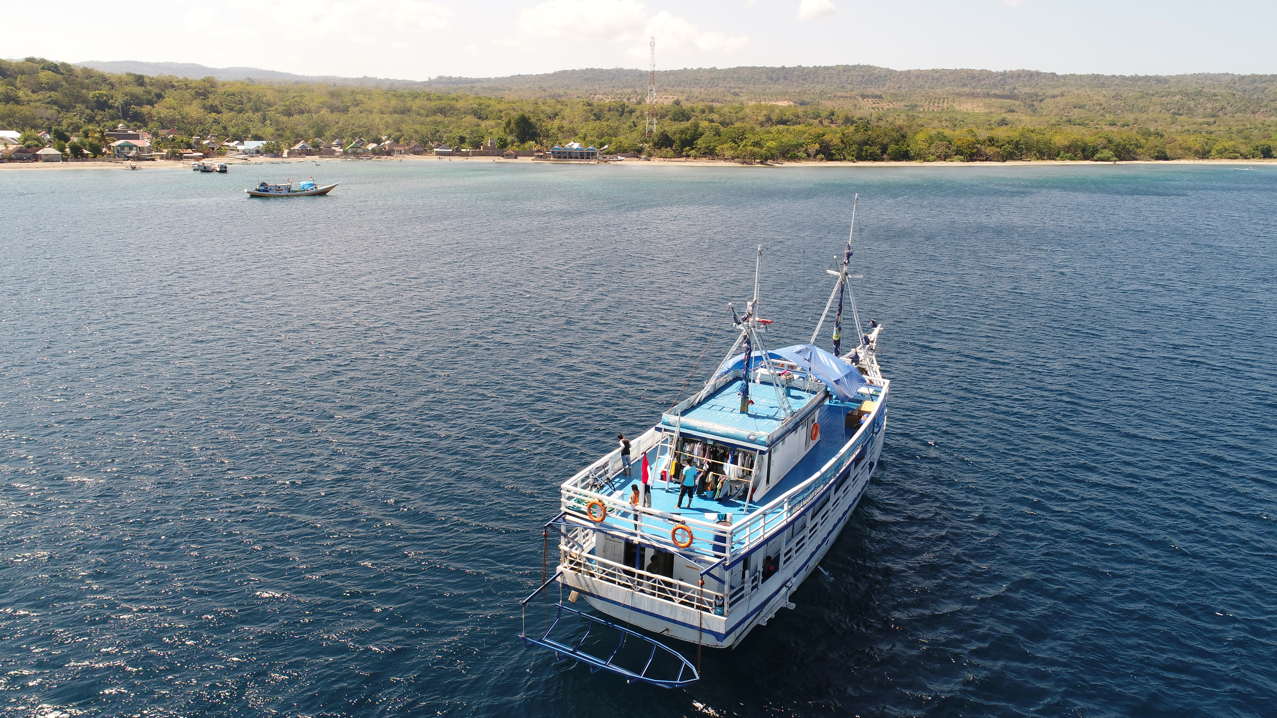

Slide 5
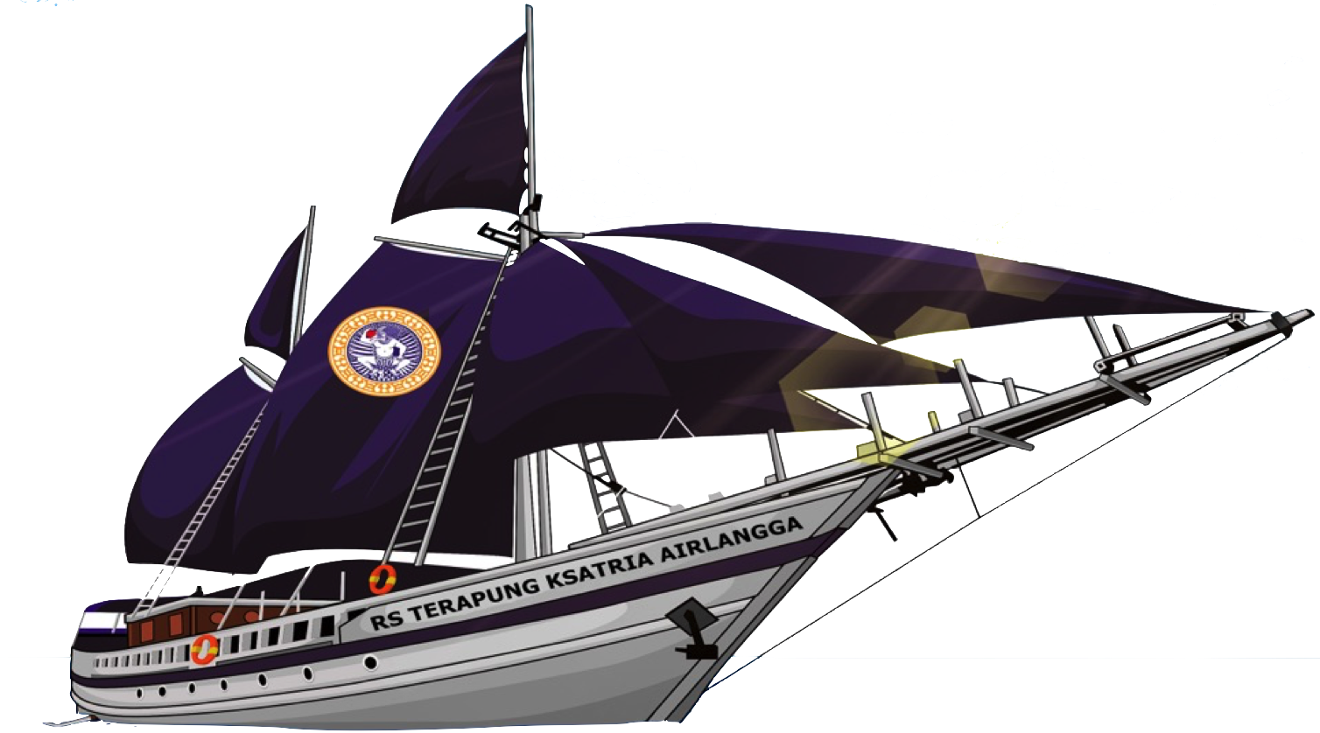
How do we approach
Reaching out the out of reach
Become the solution by conducting comprehensive medical services for the people who live in remote island in Indonesia that they can not get from puskesmas
We send our hospitalship and specialist doctor and team, to come to the remote islands
To provide a standardize health care
For free
We finish their problem in their island
Make the people does not necessary to be referred to the hospital anymore, which locates far away from their home

Slide 6
The main services/program
We have three criteria in destination determination :
Difficult to reach.
The more difficult to reach the more suitable the location is.
The more isolated, the more precise our mission is
Lack of health services, especially the absence of specialist doctors/hospitals
Supported/licensed by local government
Almost all outer islands are suitable with the criteria
9 of 111 outer islands had been served
We commit to prioritize these outer islands

Slide 7
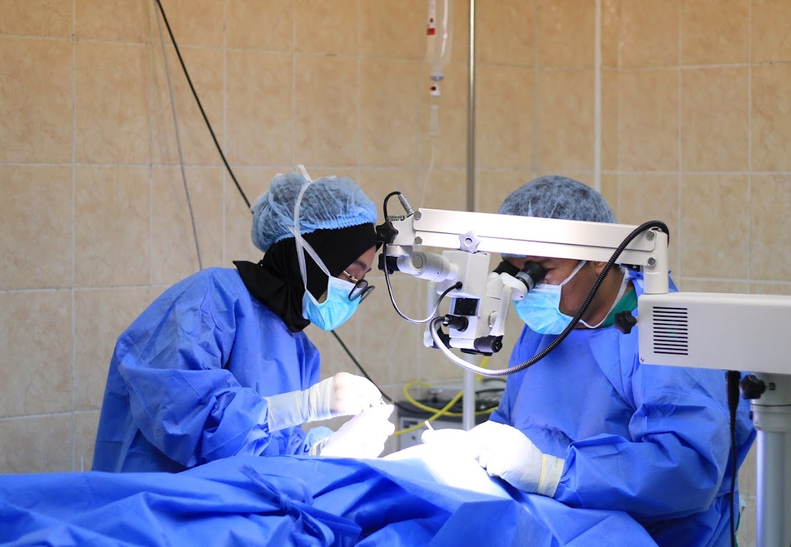
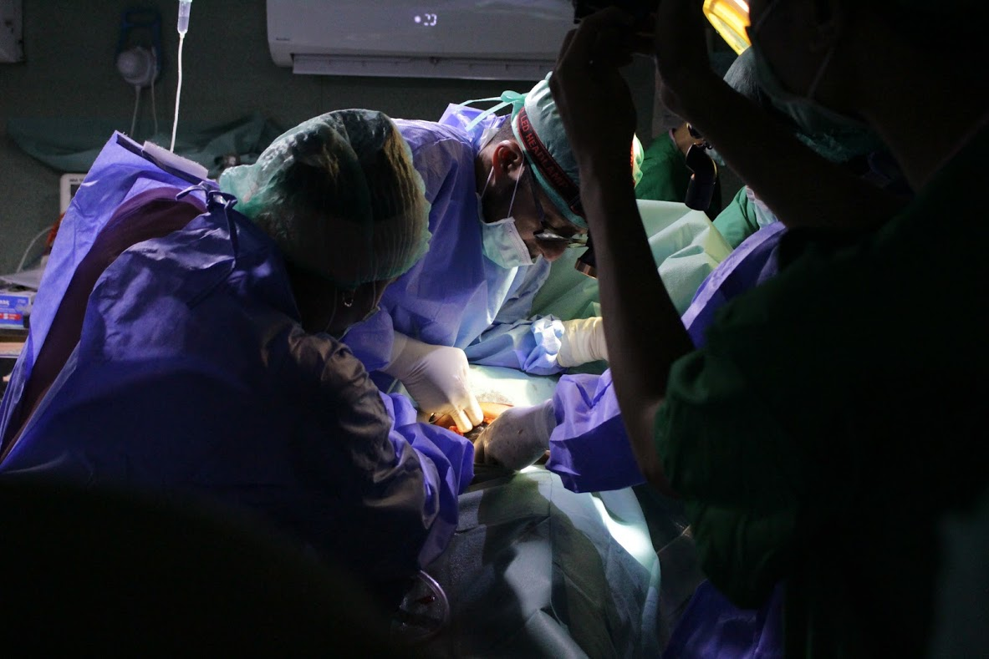
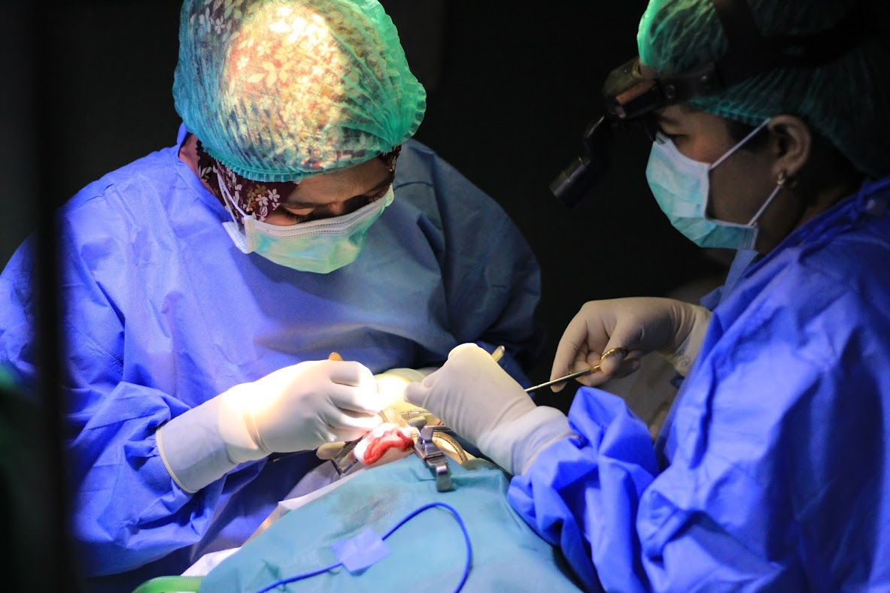
operating theater

Slide 8
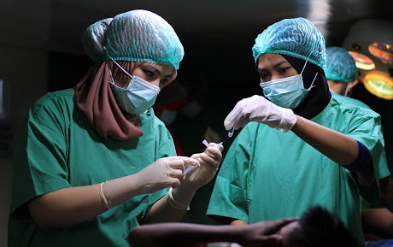
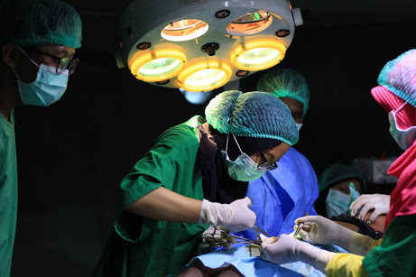
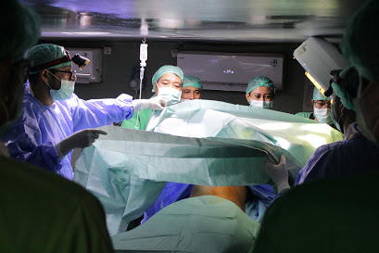

Slide 9
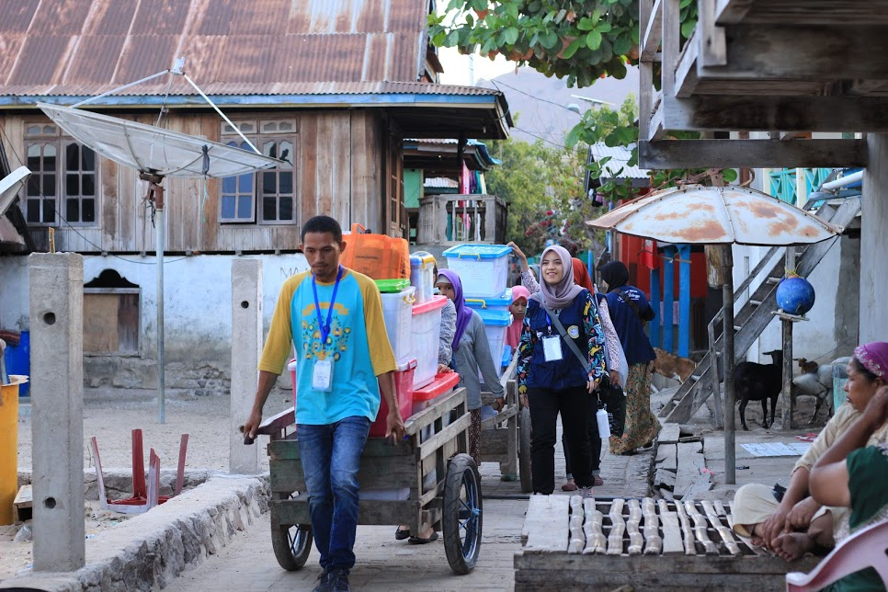
WHY
PEOPLE IN REMOTE ISLANDS
Lack of access
Lack of information & communication
Lack of welfare
Lack of health personnels
Lack of health services
THE PEOPLE OF THE MOST IN NEED

Slide 10
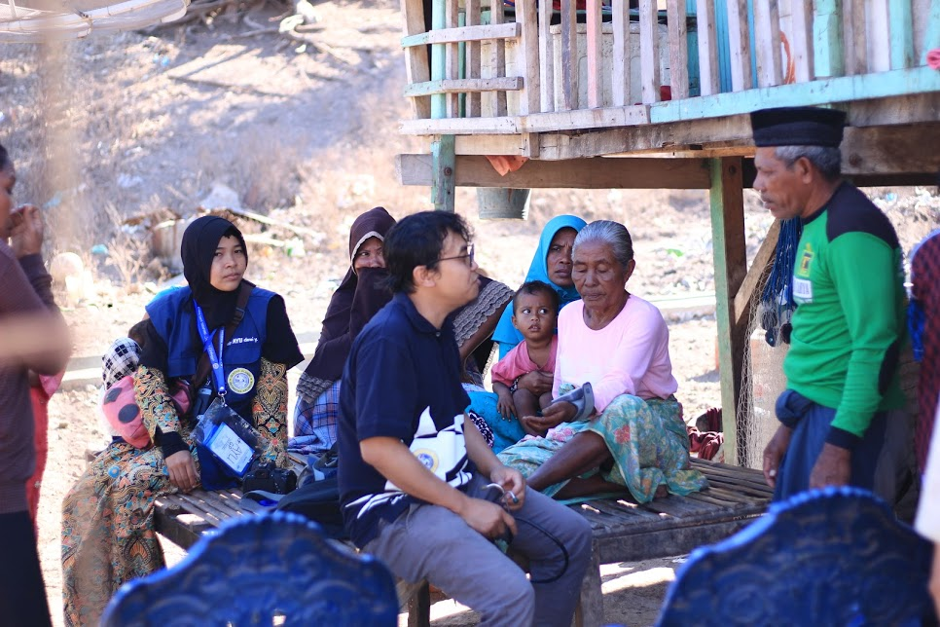
What we are
A non-profit organization
Presented by Alumni Society of Airlangga University
Guiding value: Love & Honesty

Slide 11
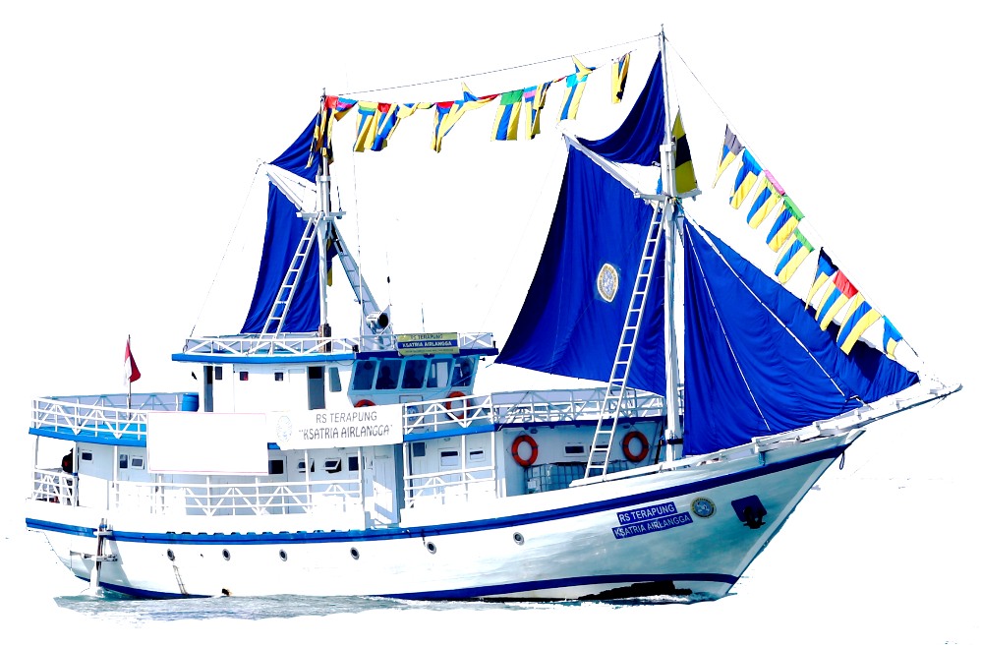
KSATRIA AIRLANGGA MISSION 19 November 2017 – 08 December 2018

Slide 12
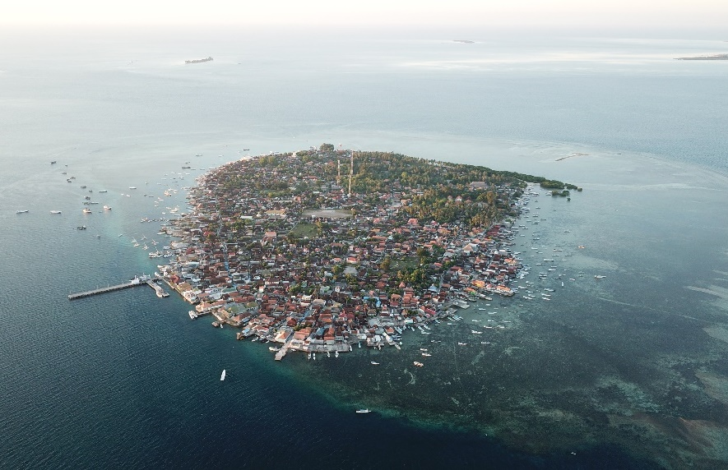
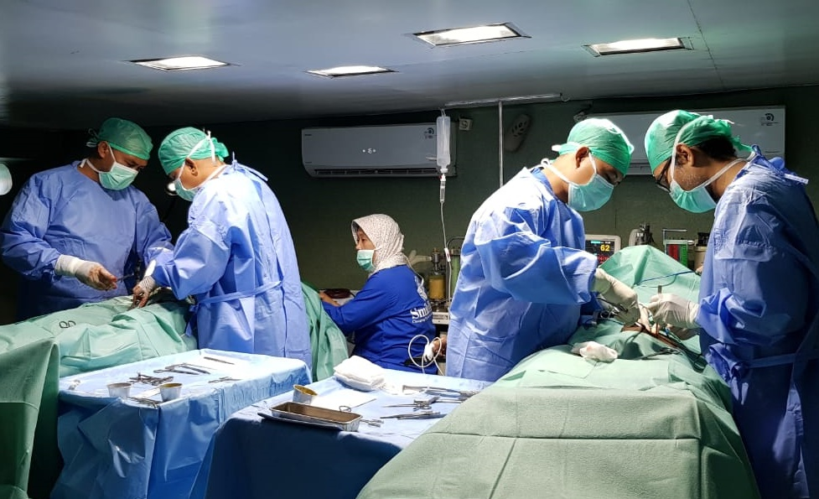
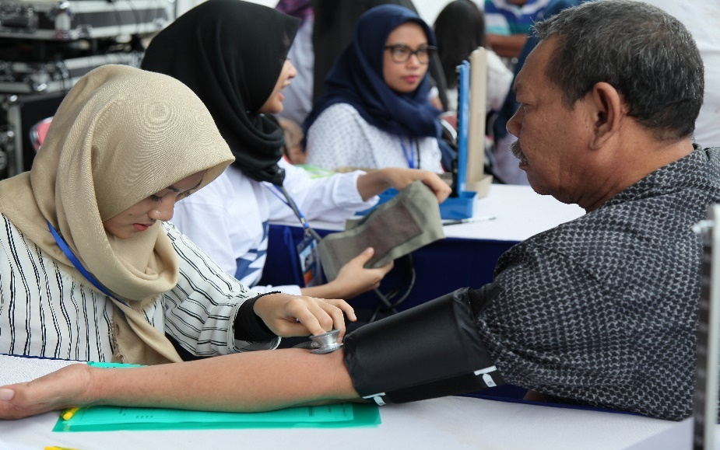
RECAPITULATION KSATRIA AIRLANGGA MISSION
GP & Spesialistic
Surgery
Visited island
22
1.532
13.257

Slide 13
SURGERY
790
OPTHALMOLOGIST
Pterigium 448
Catarract 342
MINOR SURGERY
Lipoma
Atheroma
MAJOR SURGERY
Hernia 180
Struma 29
Papiloma
Ganglion
TE 21
FAM
SC 14
383
359

Slide 14
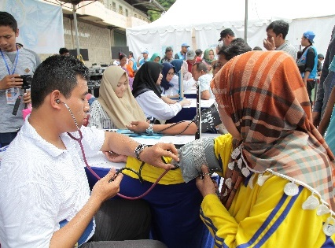
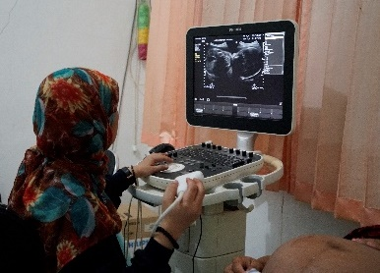
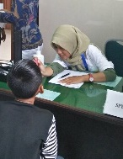
GP & Specialistic Medical Service
General Practitioner
Pediatrician
Anaestesiologist
General Surgeon
Plastic Surgeon
Obstetric & Gynecologist
Ophthalmologist
Orthopedic
Internist
ENT&HN
Dentist

Slide 15
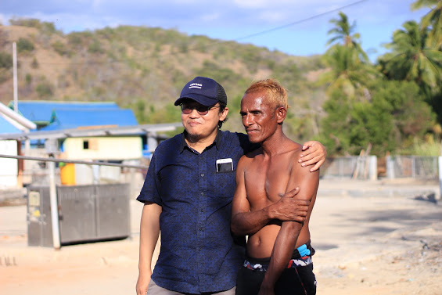
Other activities

Slide 16
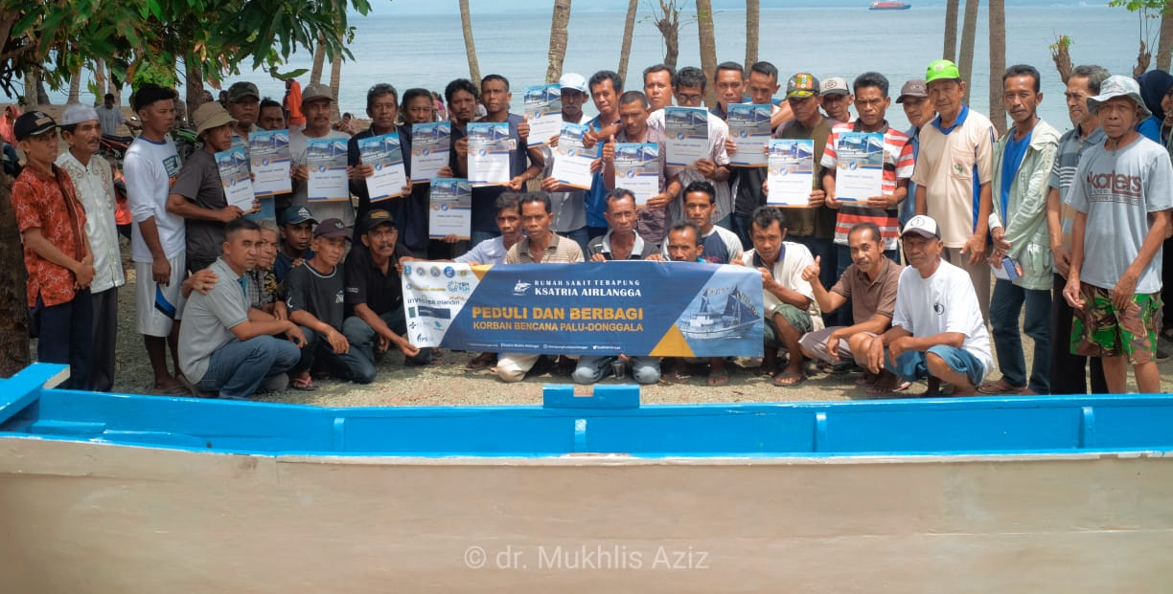
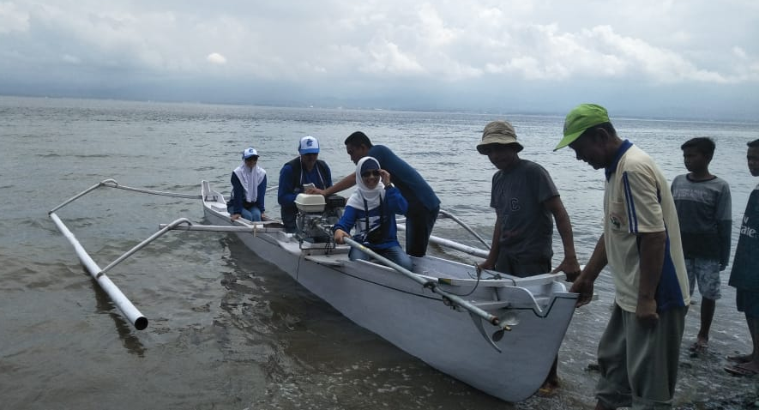
LIVE AID - Victim of Tsunami - all the boats were ruin - we help to build 70 new boats for the people - to start the economic activity
No poverty and decent work and economic growth program

Slide 17
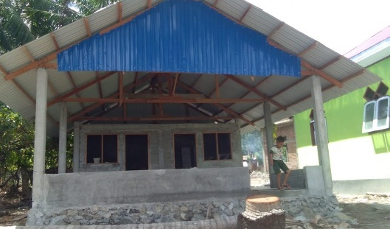
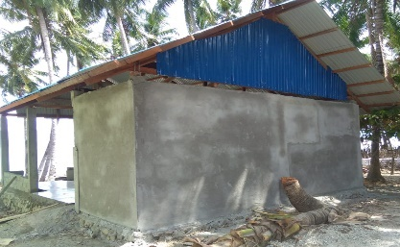
LIVE AID
Fish Auction & Cooperation

Slide 18
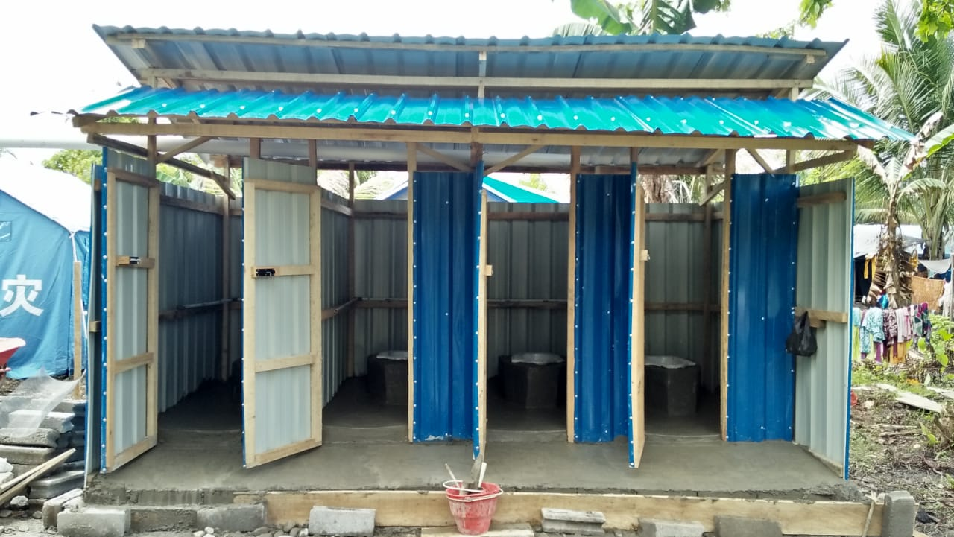
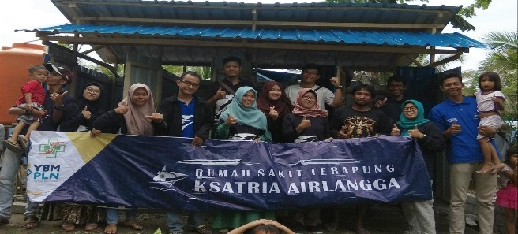
Clean Water & Sanitation Program
Water, Sanitation & Hygiene

Slide 19
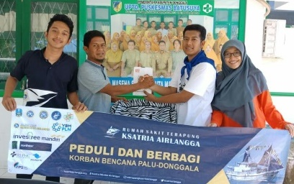
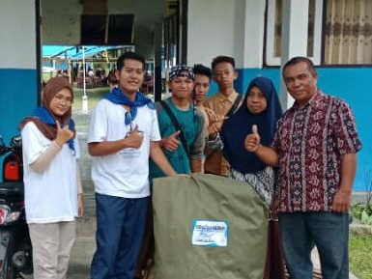
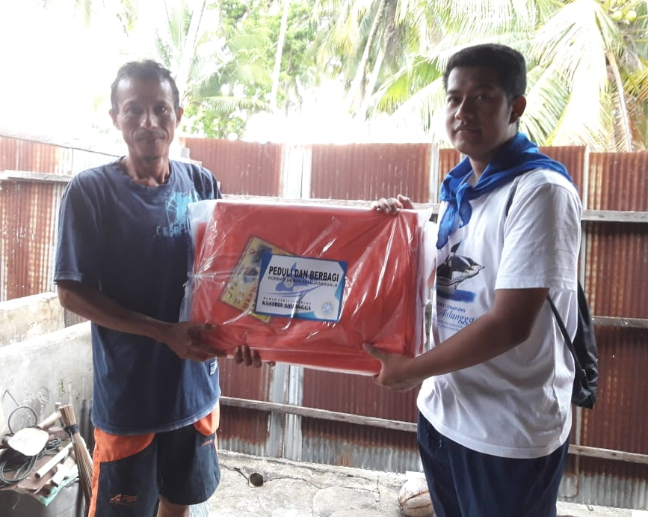
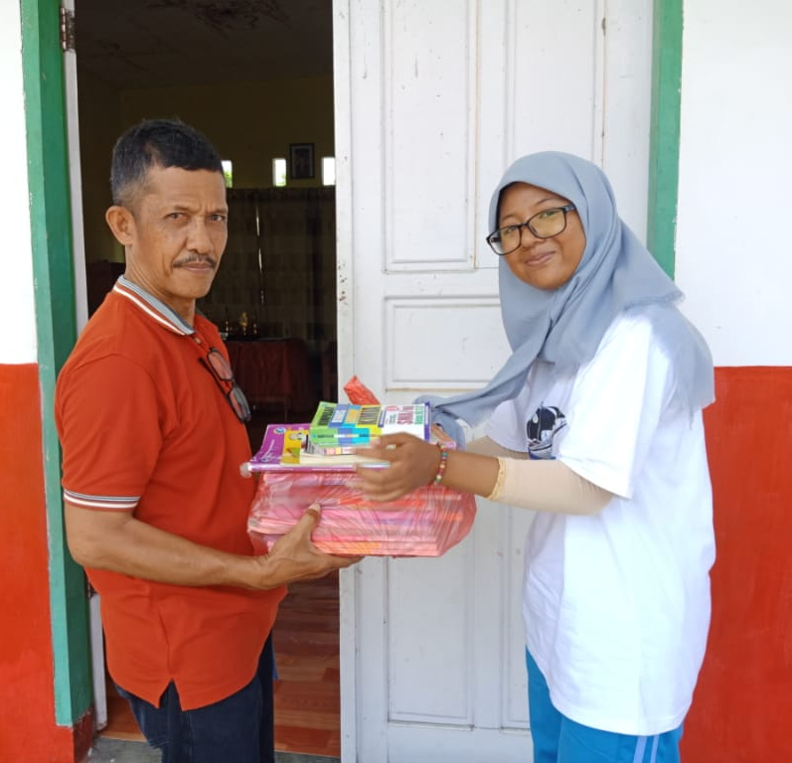
INTEGRATED SOCIAL SERVICE
Other Aid : food, blanket, tent,etc

Slide 20
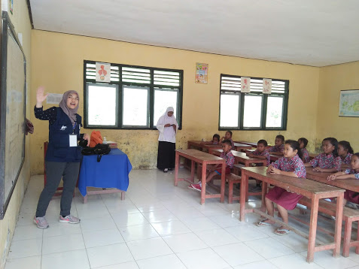
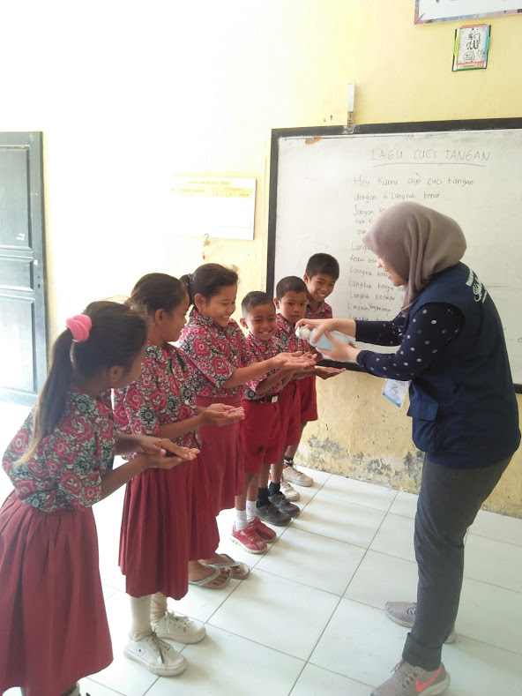
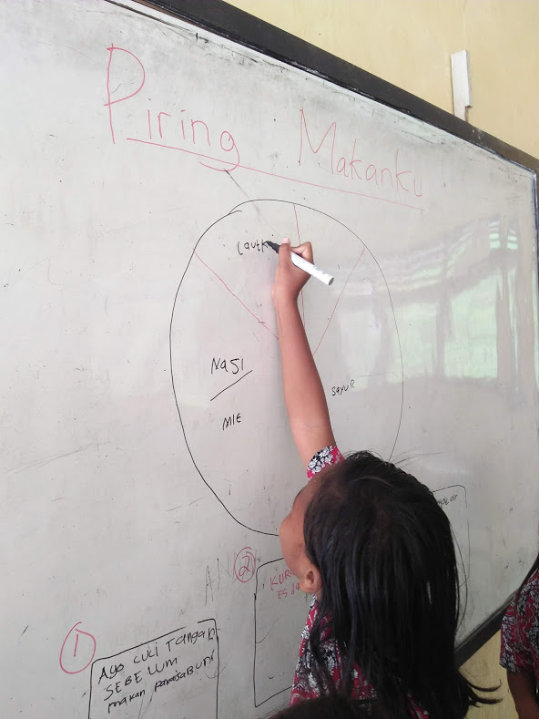
Fight against stunting

Slide 21
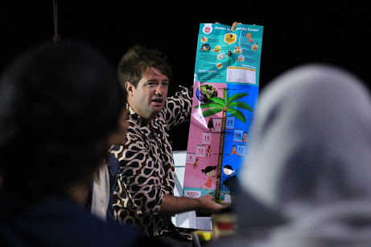
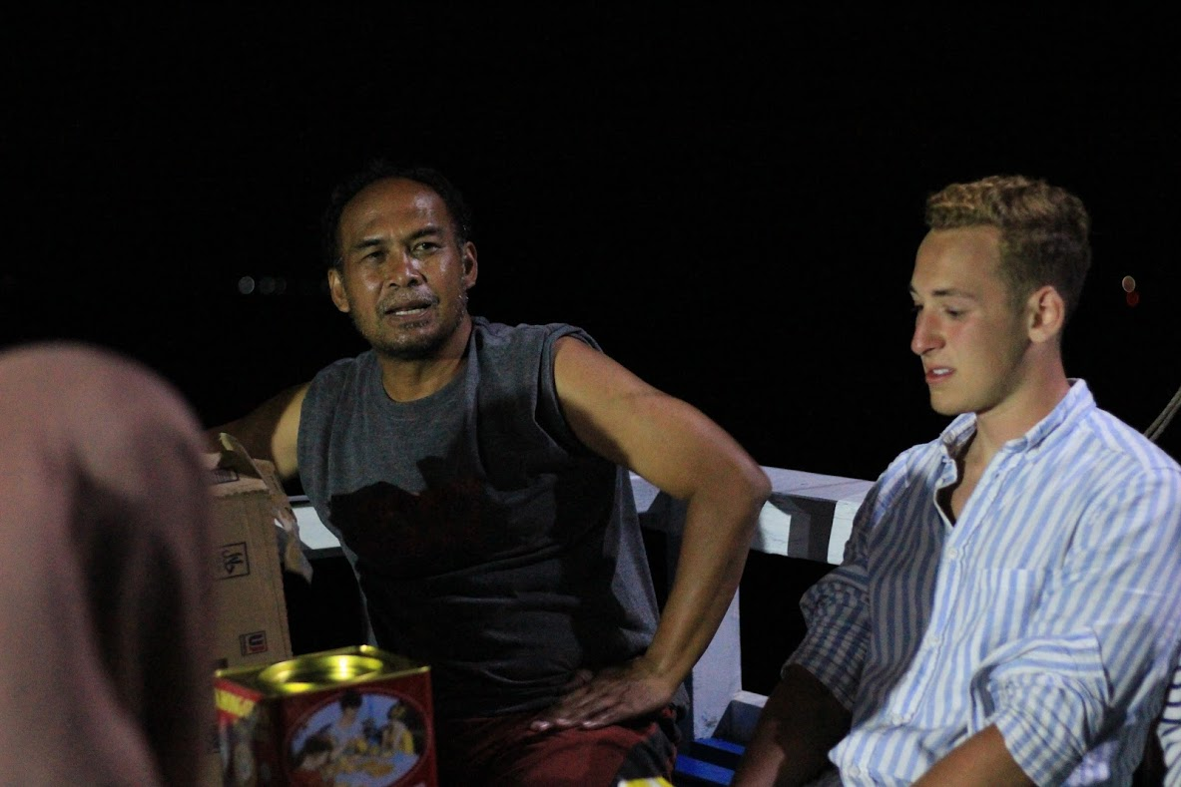

Slide 22
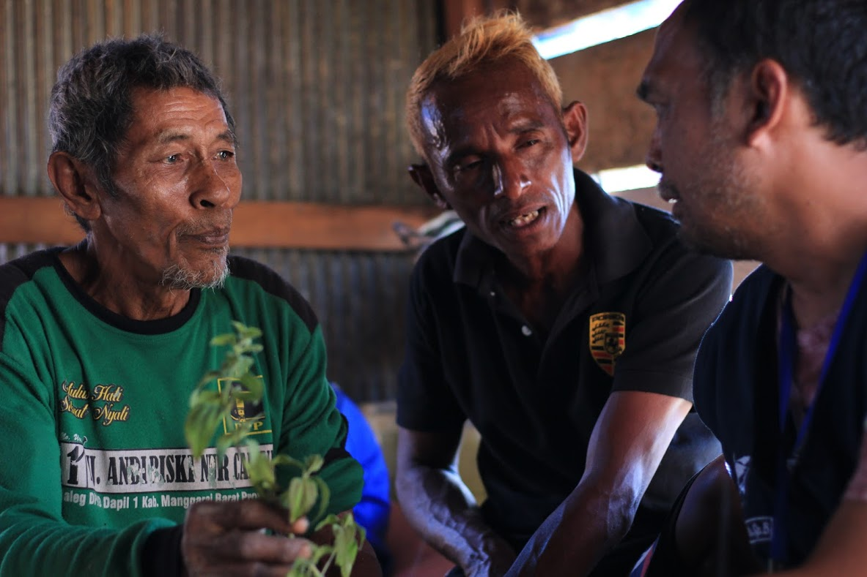
Research
Ethnomedicine and exploration (drugs discovery)

Slide 23
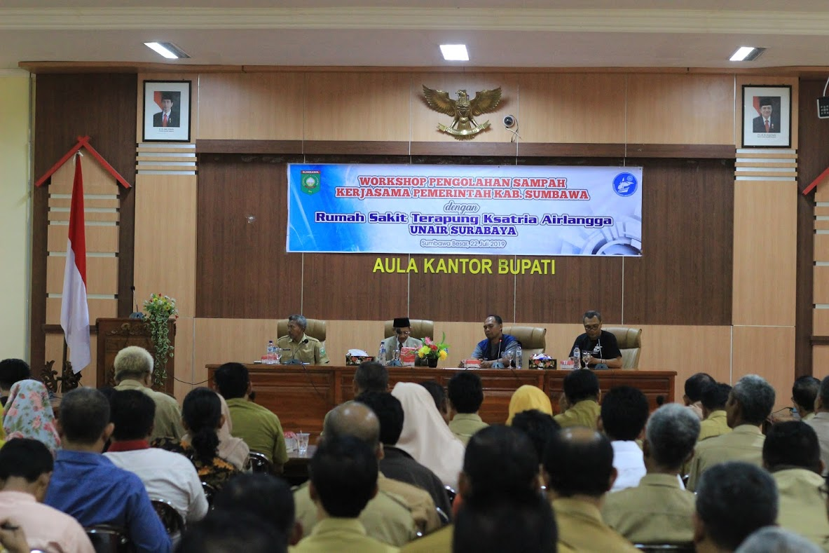
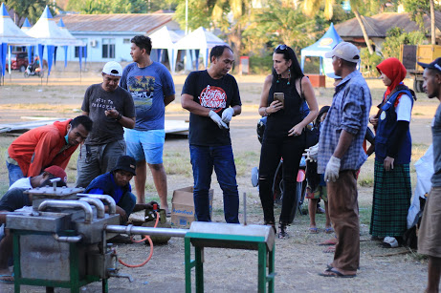
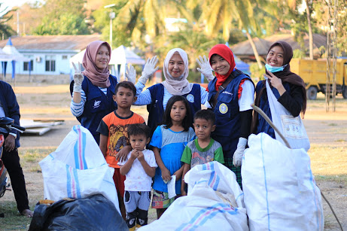
Islands Waste Management

Slide 24
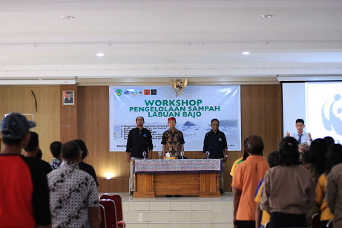
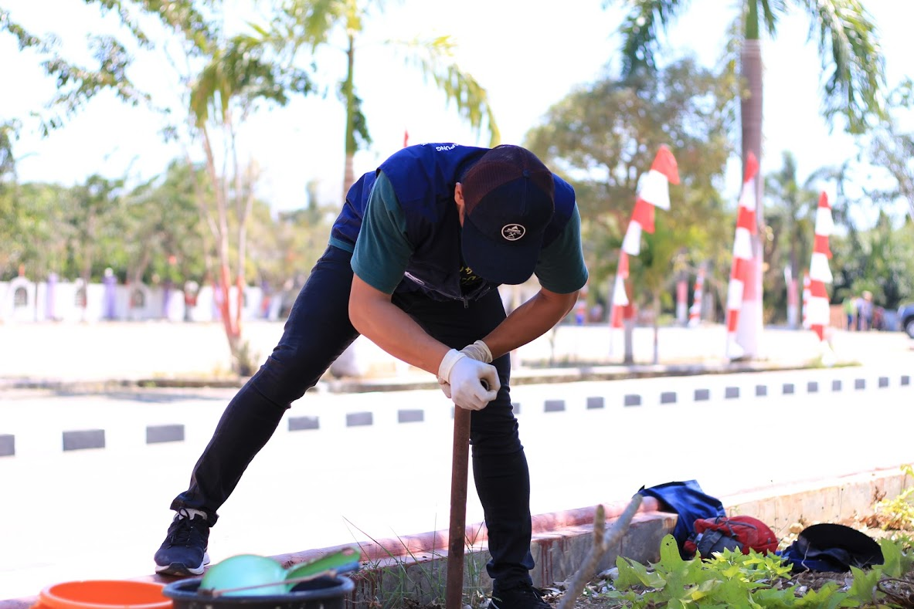
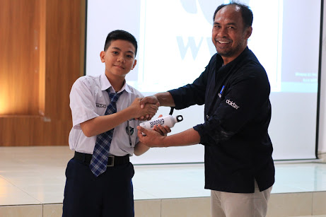
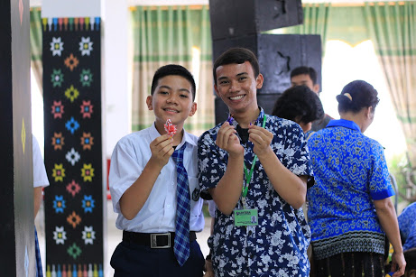

Slide 26
OUTER ISLAND MEDICAL EXPEDITION
2019-2020
KSATRIA AIRLANGGA HOSPITALSHIP

Slide 27
RENCANA BAKTI KSATRIA AIRLANGGA TAHUN 2019
KEGIATAN
TEMPAT KEGIATAN

Slide 28
The last position of the ship

Slide 29
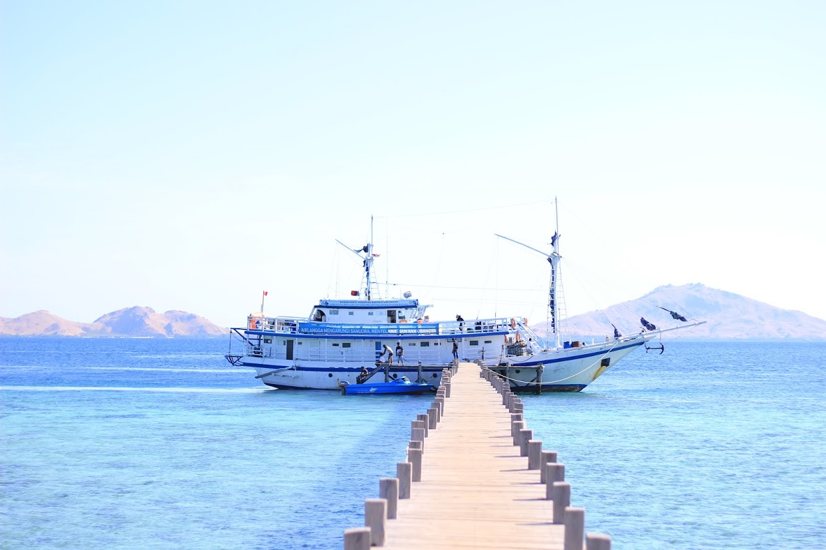
WHAT NEXT?
Our hand is not long enough to reach them all
Just give them your heart, give your hand, and together we reach them, to serve and to empower them
Join the mission with us
For what?

Slide 30
Strategic Practices in Bringing the Solution for Community Health in Small Islands

Slide 31
(be the) SOLUTION

Slide 32
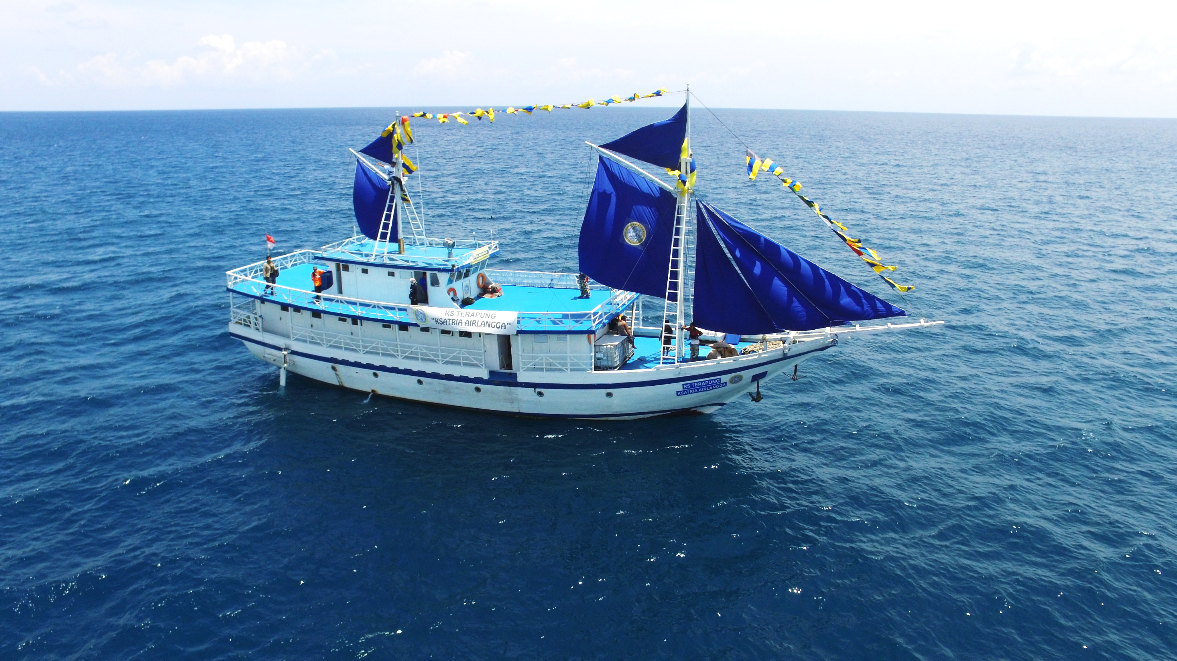
Do you know something inside this hospitalship?
Nothing, but love….

